Slide 1
2014 CYAC Summer
Arduino Course
Lecture 02
Basic Input and Output
吳振豪

Slide 2
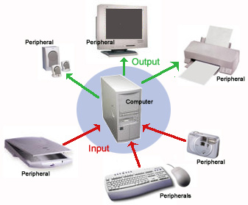

Slide 3
Input and Output
Inputs
Outputs
What is digit ?
The digital IO pins

Slide 4
Take note

Slide 5
Write code in Arduino IDE
Control digit IO pin via API
- (Application Programmable Interface)
The difference between write in setup scope
and loop scope

Slide 6
Take note

Slide 7
Control and Delay
What is delay means in Arduino ?
Use delay to control LEDs

Slide 8
Take note

Slide 9
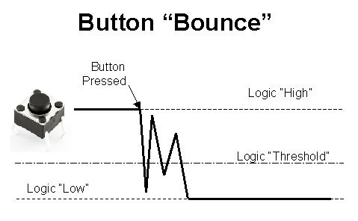
Read digital input
Button or Switch type
There is more http://en.wikipedia.org/wiki/Switch
Bounce

Slide 10
Debounce
Tutorial link - http://arduino.cc/en/Tutorial/Debounce

Slide 11
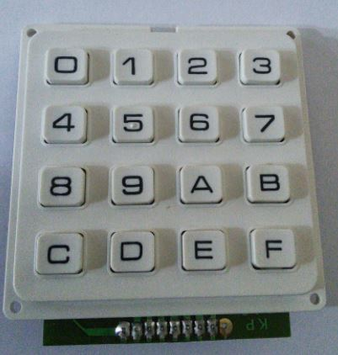
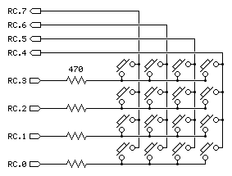
Keyboard
Scan keyboard

Slide 12
What’s the advantage with scan keyboard

Slide 13
Read a keyboard
First activate one row then read each column, then loop while each row had been done.

Slide 14
Take note

Slide 15
Practice
Please add your personal signature at the head of code
Let LED flash 1 sec
Control 4 LEDs flash in loop
Why Arduino control single IO pins at once
Use a button to control LED

Slide 16
Read a scan keyboard

